Slide 1
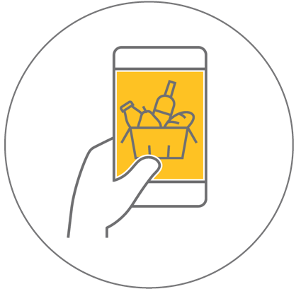


Slide 2
Agenda
Online Grocery Overview (5 mins)
Themes Walkthrough
Behavior Shaping (10 mins)
Delivery Experience (10 mins)
One more item in the basket (10 mins)
Customer Retention (10 mins)
Questions (15 mins)

Slide 3
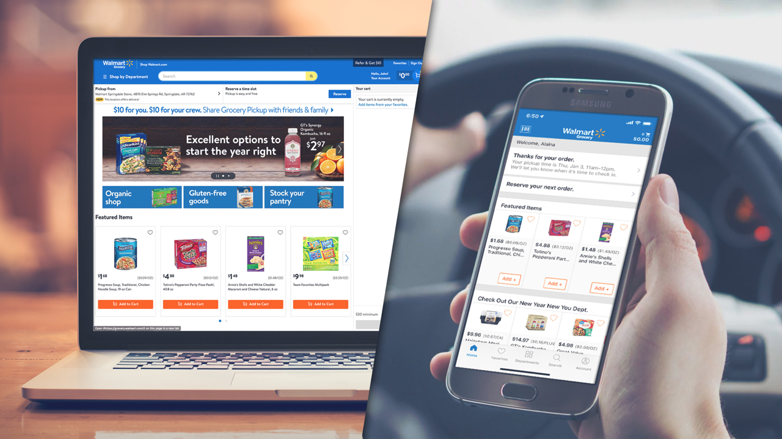

Slide 4
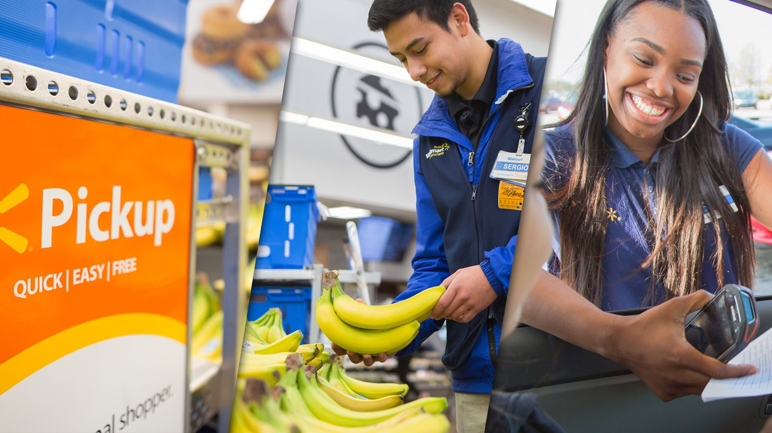

Slide 5




Each store has its’ own microsite
Customers can see assortment that reflects their local store.
120,000 SKUs live… and growing
Over 180,000 SKUs sold with all seasonal and modular item change outs in 2018.
Over 1 Million orders a week
Online Grocery at scale requires even more focus on creating efficiencies and precision of products at shelf for in store and online customers.

Slide 6
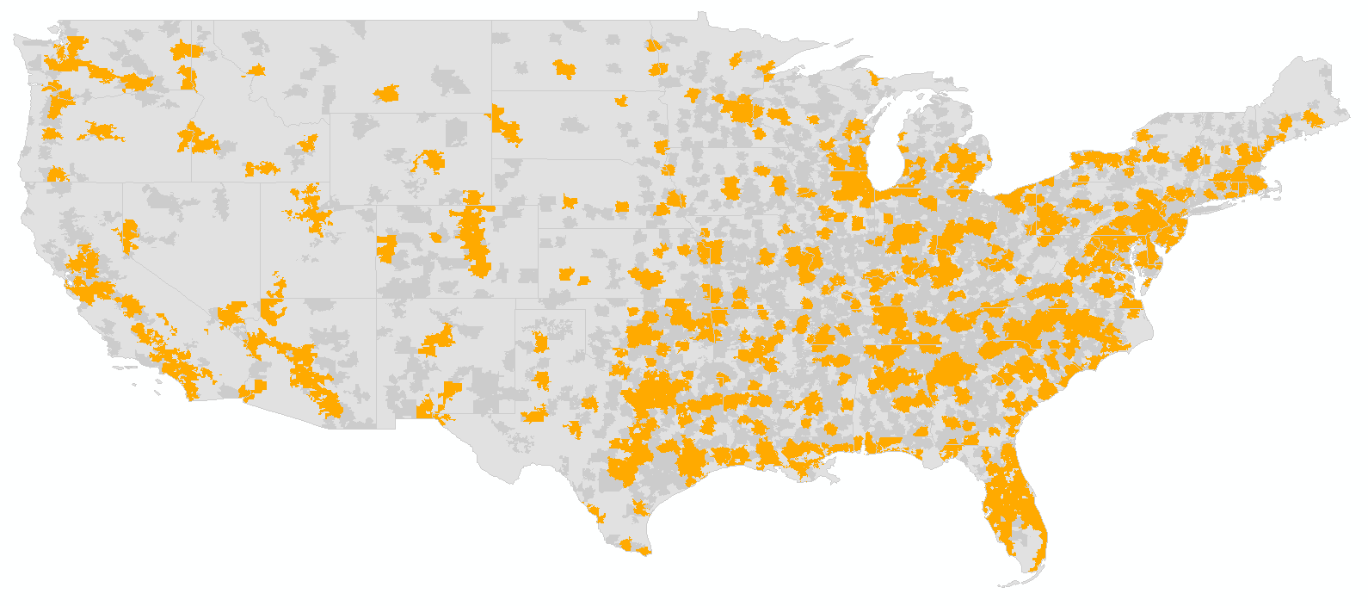

Online Grocery 2018
430
2140
69%

Slide 7
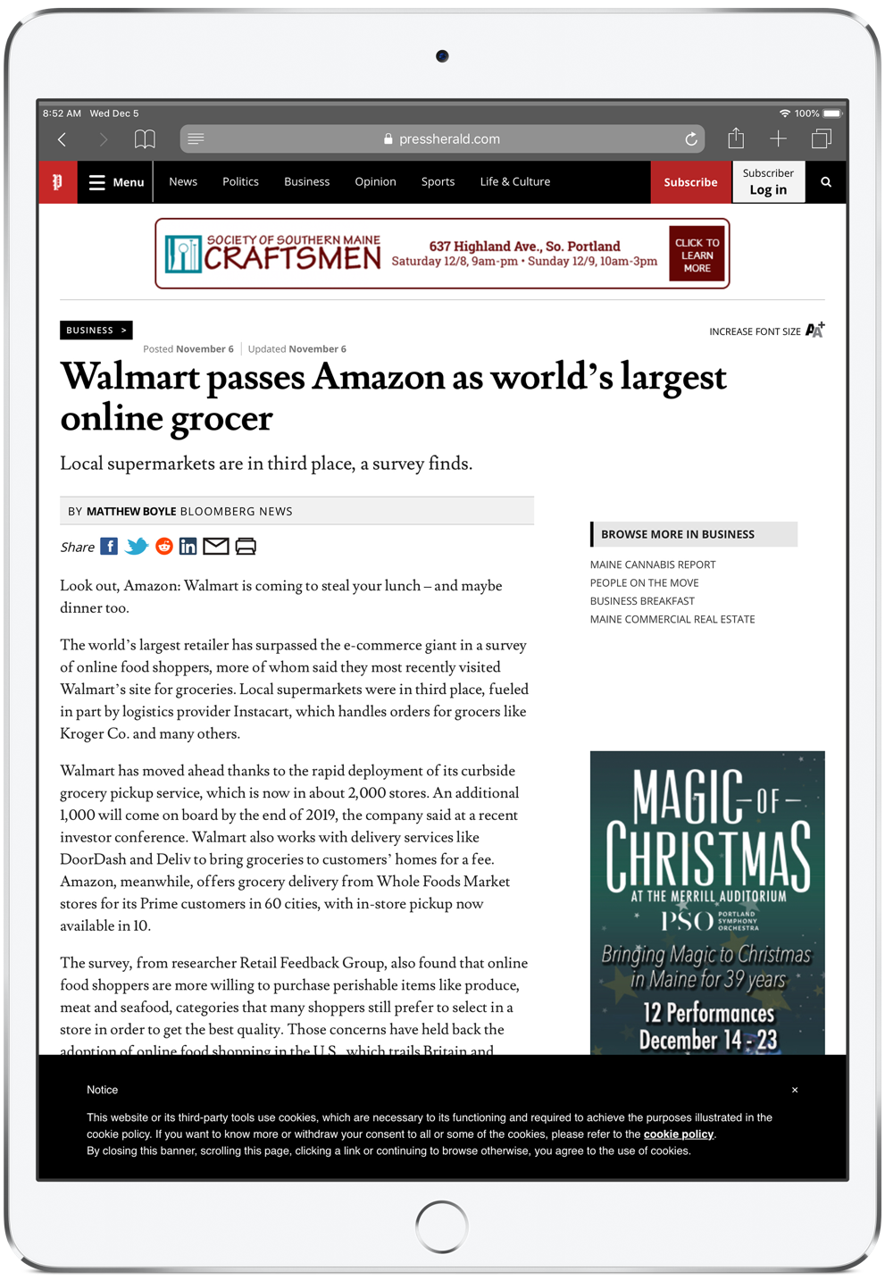

Slide 8
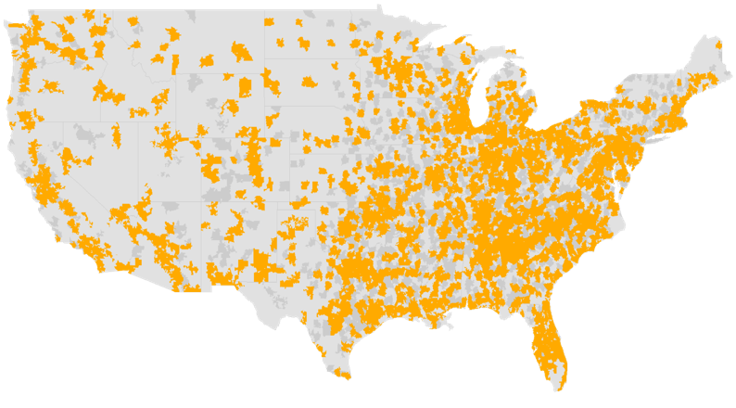
Online Grocery 2019
740
3190
78%

Slide 9
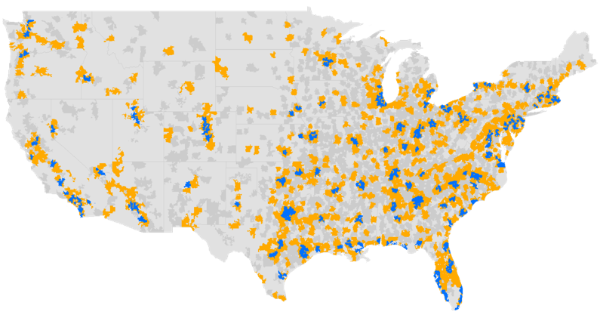


Online Grocery Delivery 2018
113
779
36%

Slide 10
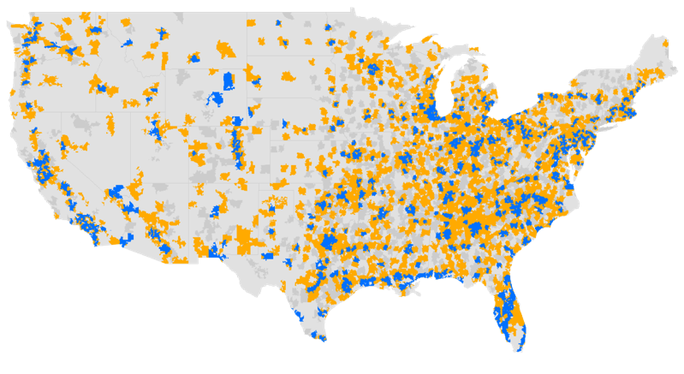
Online Grocery Delivery 2019
190
1600
53%

Slide 11
Hack OG Themes
Aim is to solve an actual business problem (existing or future) in the following 4 directional themes
1
2
3
4
Behavior Shaping
Delivery Experience
One more item in the basket
Customer Retention
Desired outcome:
Encourage customers to come during their designated pickup slot and influence customers to come when its less busy
Business Value:
With given operational bandwidth and labor constraints, optimize wait time for all customers.
Desired outcome:
Enhance the overall delivery customer experience
Business Value:
Delivery is a growing segment for Online Grocery and a key competitive battleground. We have to ensure the experience is top notch.
Desired outcome:
Encourage our customers to build bigger baskets efficiently and discover new items to add
Business Value:
Online Grocery plays a critical role in Walmart eCommerce revenue growth and bigger baskets help drive that growth.
Desired outcome:
Improve retention amongst both existing and new customers
Business Value:
With current churn rates, OG is at risk of ~8M orders in FY20.

Slide 12
Behavior Shaping Presenter: Surnaik Srivastava

Slide 13
Behavior Shaping – Growing pains
Every week 300,000 customers are late to pick-up their orders, more than 150,000 of them are late by over 15 mins
“Customers selecting early morning time slots due to the 4-6pm time period full and then the customer coming to the store during the 4-6 pm time period causing an over flow of cars at one time. In high volume stores averaging 1200 orders per week can have over 30 cars during one hour.
We are getting a lot of poor comments from these customers that are not coming in on their designated time slot, and this is putting a lot of pressure on the store staff to service a lot of cars during the 4-6 time frame”
-Central Ops OFC Team

Slide 14
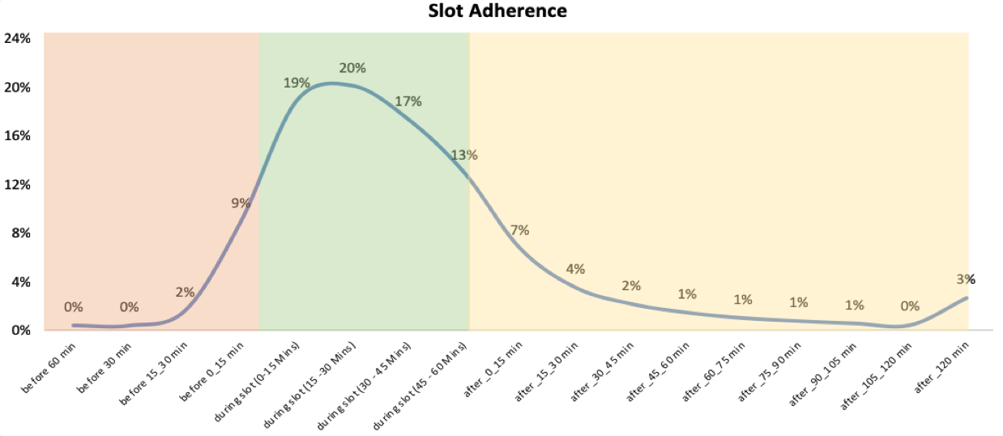
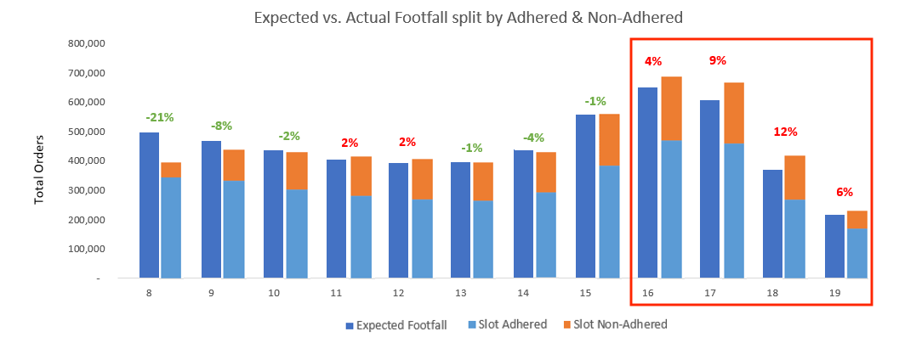
Behavior Shaping - Intro to Snowball Problem
69% of all the customers are slot Adhering
85% of the all customers show up within +/- 15 minute of their slot time
15% of entire customer population is outside the ‘extended customer pick-up block’
Snowball or spillover effect generally impacts the hours that are later in the day
During these 4 hours, 4pm – 7pm customers showing up exceeds planned customer ‘footfall’ for the hour
Red percentage shows the difference between what customer traffic was expected at 100% slot compliance vs what actually showed up

Slide 15
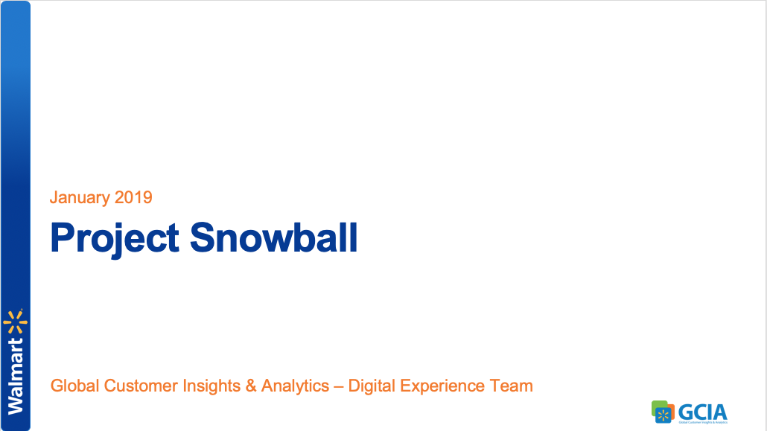
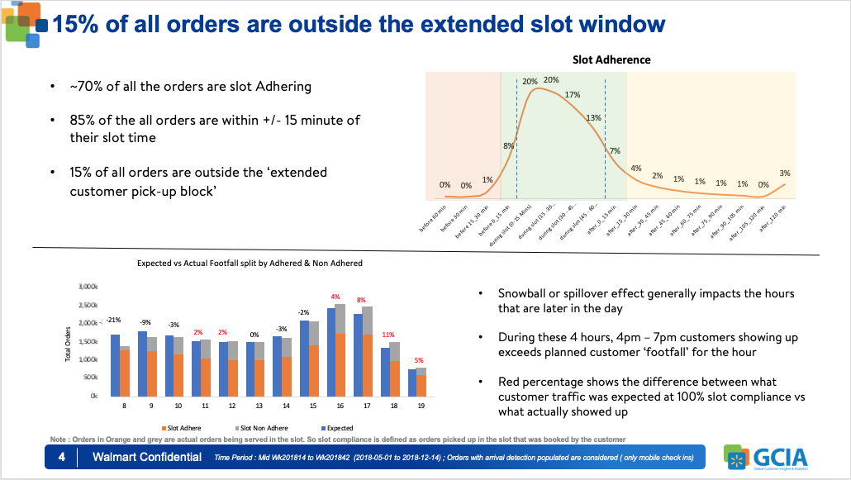
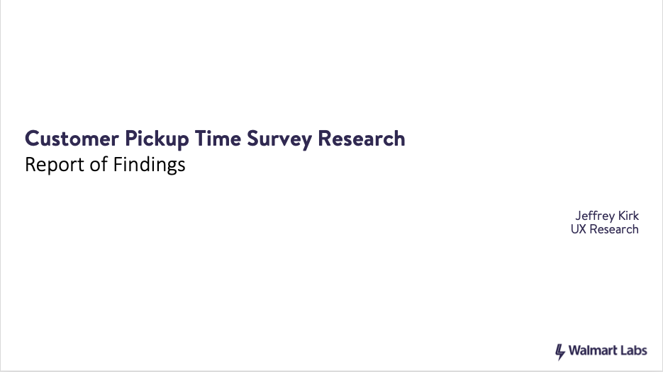
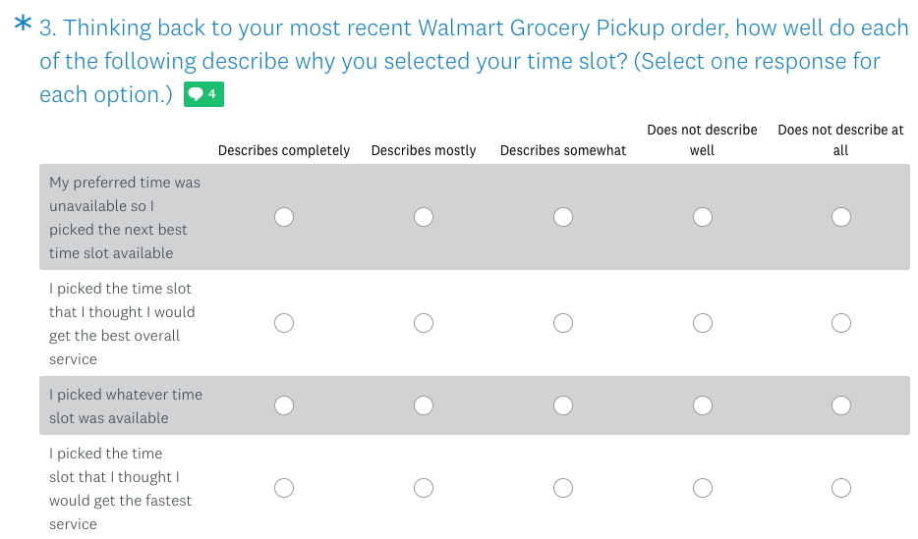
Behavior Shaping - Research Work Already done
GCIA Customer data deep-dive
28 Weeks of data
20 million order data
4 levels of data slicing
13 million customers
+
Combined findings are in subsequent slides
Late Customer Survey deep-dive
Emailed 14,000 customers
1000+ Responses
Habitual & One time offenders
14 Questions

Slide 16
Behavior Shaping - Output of the Study
Something came up
Thought it was okay to come late
Came when they were free
Key Insight
Customer mental model: It is just a pick-up, nothing urgent
Problem Statement
Build solutions to influence customer behavior and mental model to -
1
Customers are showing up in the hour that they were selected
2
Customers are showing up in the hour that we want them to that are low traffic hours

Slide 17
Behavior Shaping - Solutions already in flight
Demand Shaping – Push/Pull UI: During slot selection, we will actively engage customers and tell them which slots are busy and will have higher wait time. The goal is that this messaging will prompt some customers to move away from rush hours into a slot that will have a lower wait time. This test is slated to go-live in early May.
Updated messaging of the pick-up proposition: We will be actively messaging to the customers why arriving within the slot is important. Also, we will be trying to influence the customer’s mindset that it is not okay to come late. Specific action items around this are in discovery phase and we should hear more tangible outputs as we finalize Q2 roadmap. Other things are – add to calendar, share with alternate person
We missed your email: We have an email that is getting created, that will be triggered if customers miss their slots and asking them to call us to tell us when they will showup. Future plan is to ask customers who are late to select another slot in the day that is not rush hour using that automated email.
Intra-hour optimization: We are actively trying to push the customers to the center of the hour so that cars are more evenly distributed throughout the hour. We have a test slotted to go live in week 10
Comms Throttling: This quarter we are planning to run another test that will send order ready email to customers at different times so that they leave for stores at a different time, enabling smoother parking lot traffic
Changing the name of pick-up slot to pick-up appointment

Slide 18
Delivery Experience Presenter: Kara Boehm

Slide 19

Delivery Experience – Customer Journey
19
Native Live Order Tracking
Awareness
of delivery
Build basket
Checkout
Order
progress
Driver arrived
Delivery confirmation
Reorder
Add address
Book slot
Order confirmation
Driver on the way
Driver/customer handoff
Post order
Digital Tipping
Driver Feedback

Slide 20




Delivery partners
Roadie
Door Dash
Postmates
POINT PICKUP
Axlehire
SKIPCART
SPARK
ASSOCIATE
FORD
UDELV

Slide 21
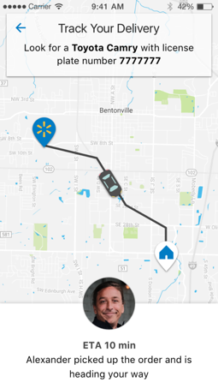
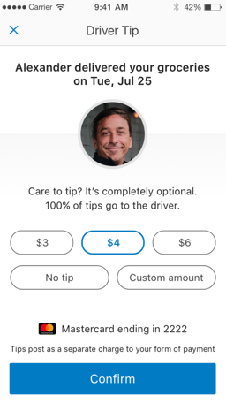
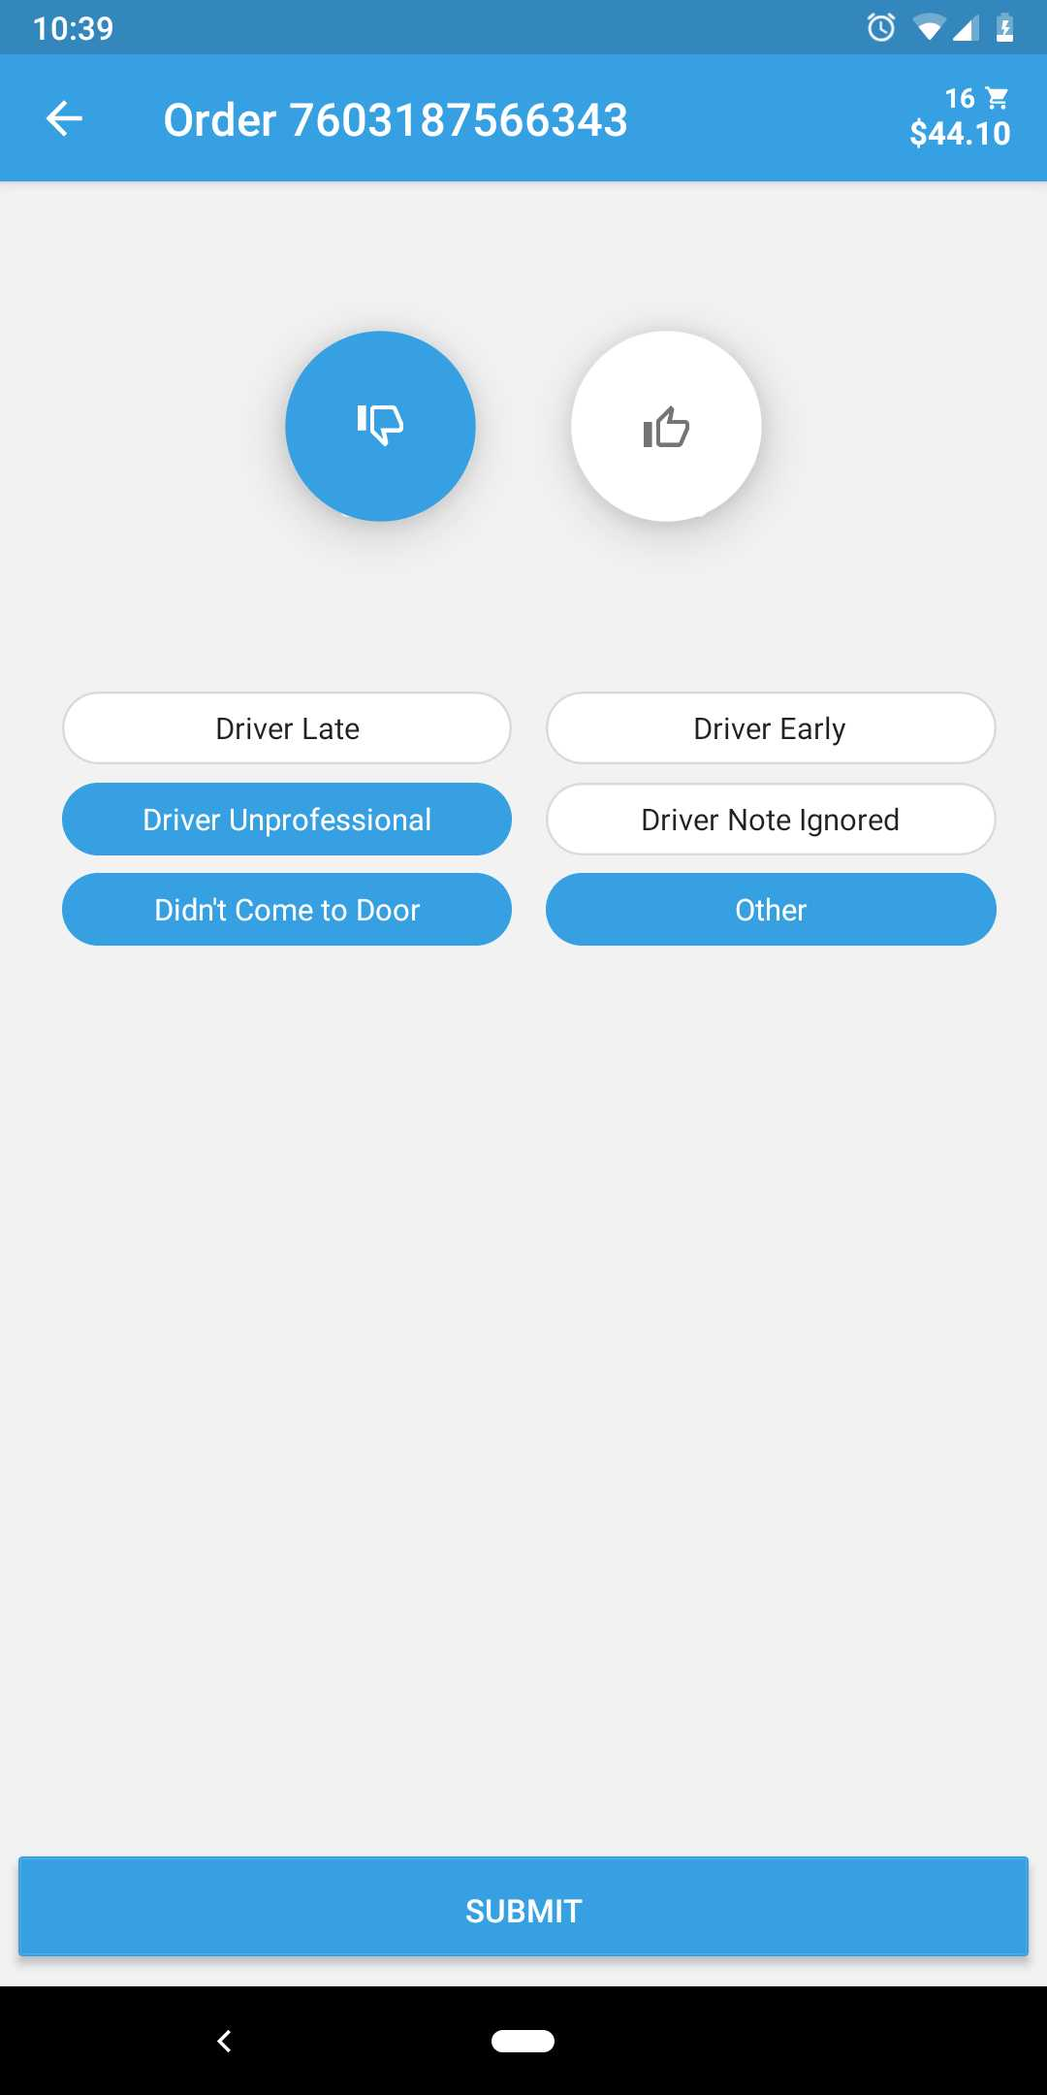
Delivery Experience – Core Features Live Today
Live Order Tracking
Tipping
Driver Feedback

Slide 22
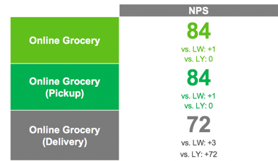
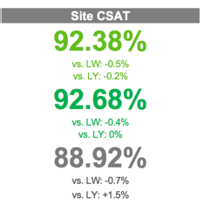
Delivery Experience – Ordering experience and mobile discoverability
NPS & Site CSAT
As of Week 1 FY20
Mobile Adoption
Q4 FY19 (vs Q3 FY19)

Slide 23
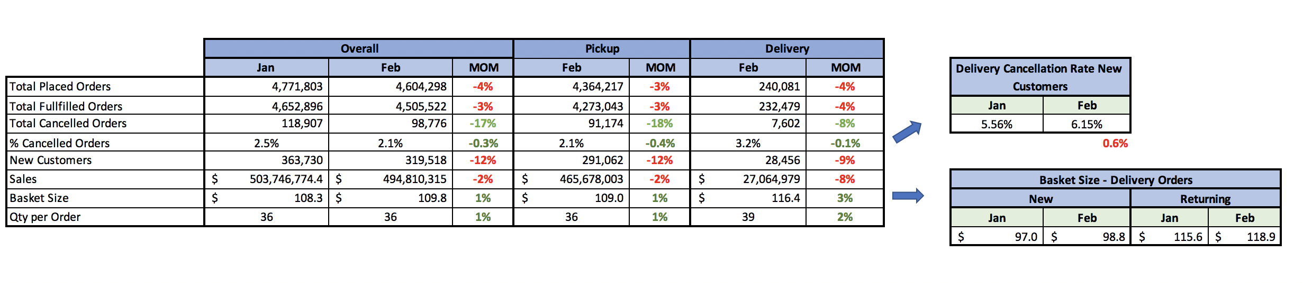
Delivery Experience – Higher basket size & Qty per order
Business Review — February FY20*
Delivery =
5.2% of overall OG orders

Slide 24
Delivery Experience – Higher basket size & Qty per order
Delivery =
5.2% of overall OG orders

Slide 25
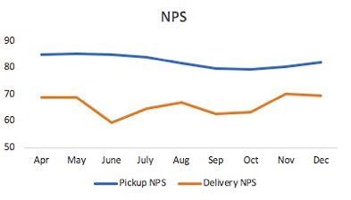
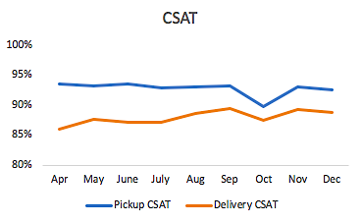
Delivery Experience – Focus to improve experience metrics to match pickup
December FY19 Metrics
NPS & CSAT FY19

Slide 26
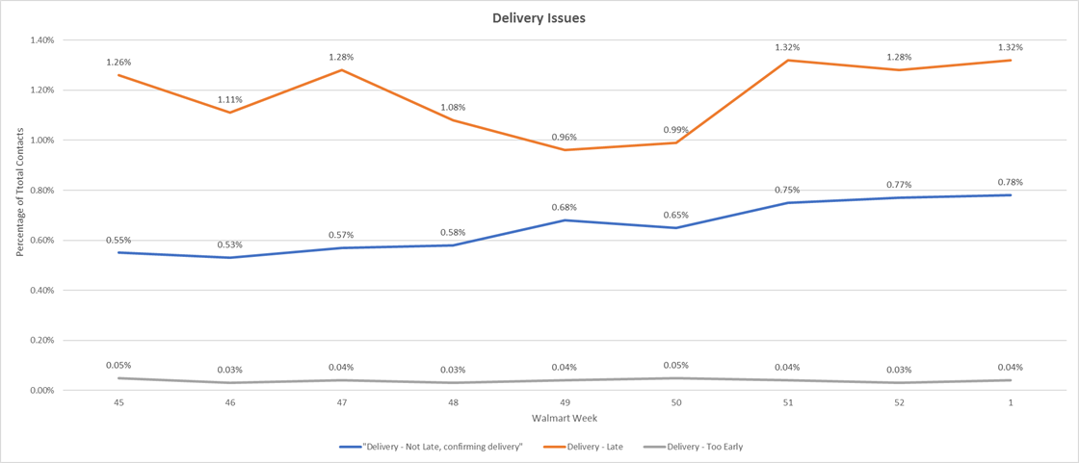
Delivery Experience – Delivery Issues: Contact volume as a % of total contacts
Delivery = only approximately 5% of total orders
Above three contact reasons comprise approx. 2% of all contact volume (for pick up & delivery orders)
50,000 total contacts/week x 2% of total contacts = 1,000 contacts/week
$6 average cost to handle a contact = $6,000/week cost to call center

Slide 27
Delivery Experience – Opportunities within Delivery Customer Journey
27
Low engagement with LOT
Map refresh every 30 seconds
Customer can’t contact driver
Fulfillment option defaults to pick up
Don’t store phone number to account
Awareness
of delivery
Build basket
Checkout
Order
progress
Driver arrived
Delivery confirmation
Reorder
Add address
Book slot
Order confirmation
Driver on the way
Driver handoff
Post order
Must add address to check for delivery eligibility
Average hand off time = 7 min

Slide 28
Basket Building
(One more item in the basket) Presenter: Joann Tran

Slide 29
Basket Building - Missions & Journeys
Mission: Help me feed my family & take care of my home ​
​
Journeys:​
​
Make my weekly shopping more efficient and help me discover new items I might like. (Basket Building)​
I want my groceries when and where it’s convenient for me. (Slot Availability)​
I want to feel confident the groceries I receive will meet my expectations. (Item, Order, Fulfillment issues)

Slide 30
Basket Building – True Intent Study Clips
Learning #1: Our customers heavily rely on search, for multiple use cases
Qualitative learning:
Our customers use search to browse, repurchase, as well as search for specific items...
...however our UX doesn't support it
Pain points shared:
- "When I am searching for a new item, there are so many results, I am not sure which one to pick"
- "Visual clutter of items in search"
Quantitative validation:
>50% of all Add to Cart’s come from search
>20% of repurchase Add to Cart’s come from search
Search is a key tool for repurchase, even when a customer uses Favorites
36% of the top 10K queries by traffic had one keyword (“broad” search)

Slide 31
Basket Building – True Intent Study Clips
Learning #2: we do not help our customers make purchase decisions
Qualitative learning:
Customers have a difficult time deciding which item to purchase...
... however our UX does not help our customers pick an item to ATC...
…and most decisions are made at the item tile level
Pain points shared:
- “Hard to see item packaging, description, benefits when exploring items that are new to me"
- "There are too many options on the site available. Making decision based on Title / Picture alone are difficult"
Quantitative validation:
Page views for Item Tile are low
<4% of ATC's come from the Product Page / Product Details Page

Slide 32
Basket Building – True Intent Study Clips
Learning #3: discovery of “new” items can mean multiple things
Qualitative learning:
It turns out item discovery are often different versions of items customers have bought in the past...
...shoppers can be influenced by flavor, brand, price, quantity, what "looks good", what's in stock, etc.
Examples of pain points shared:
- "Can't find all sizes of my favorite items for various occasions"
- "Difficulty finding related items, other options for similar items (better price etc)"
Quantitative validation:
~61% of a loyal customer's basket, has the exact same items purchased in the past
Out of the remaining 39%, 25% have a similar item being purchased in the past
Source: Repeat Rate with Similar Items Analysis, Cohort: Customers with 10+ orders, 1/1/18-12/31/18

Slide 33
Basket Building – Goals
GMV / Visitor
Q2: “Fill the AOP gap”
Focus on driving AOS
Q2+: Revisit pain points to plan for medium term initiatives
Loyalty
Business
=
Focus:
Drive AOS
with no negative impact to CX, Frequency
or
AOS
Frequency
Feature 1:
Feature 2:
Product
Feature 3:
Feature 4.:

Slide 34
Basket Building – Current Focus Areas w/ Goal to lift AOS
Restock capabilities
Complementary recommendations (”bought also bought”)
Impulse buys
Showcase rollbacks

Slide 35
Customer Retention Presenter: Ronen Paritzky

Slide 36



Customer Retention
Lost Customers Problem Statement
Currently we lose about 70k-80k customers each week
We need to increase YOY sales and orders significantly in FY20 when only expanding to 9% more households
Attracting new customers will be harder, highlighting the importance of retention
Customer Base - Definition
Customer Base: number of customers who placed at least 1 order in the recent 13 weeks
Lost Customer: a customer who haven’t placed an order in the recent 13 weeks
Week 1
Week 13
Week 1
Week 14
Week 15
Week 15
Active Customer
Churned / Lost Customer
Active Customer
How Can We Address That?
Why are customers churning? Store operations, website, slot adherence
How can we drive different churn insights for different types of customers and services: delivery/ pickup, relative wait-time for each geographical area
How can we predict their churn and work against it earlier in the funnel?
How can we efficiently re-engage them after they churn?

Slide 37
Questions?

Slide 38
Appendix

Slide 39
Delta in Site csat between pick up & delivery:
friction in Online Ordering Experience for delivery
Awareness of delivery
Add address
Checkout
Fulfillment method defaults to pick up, must click in to discovery delivery option
Must add address in order to see whether you’re eligible for delivery
If not signed in when saving new address, have to re-enter same address once signed in
Phone number & delivery notes required fields
“Add new address” buried below the fold if many delivery addresses saved to customer profile
Add address auto-fill only on web, not mobile apps
Don’t store phone number from checkout page to customer’s account for future orders
Delivery instructions entered at checkout only save if place order (disappear if navigate away from page before placing order)
Don’t auto-populate phone number used for last delivery order on checkout page
Notes:
Variable Pricing updates on Book Slot (Q1)
Express & Delivery Unlimited use cases supported
Ensure customers know delivery is attended (Q1)

Slide 40
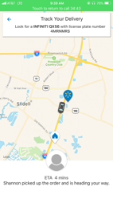
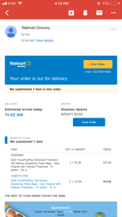
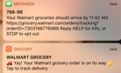
LOT represents opportunity to:
1) optimize customer-driver handoff & 2) improve delivery communication
Current Capabilities
Future Priorities
Native iOS, Android and mWeb delivery tracking
Seamless integration across CSP providers and Spark delivery networks
30 second map refresh and ETA update
Push, SMS and email notifications when driver is on the way
Email contains subs/nil pick information
Reduce map refresh to real-time / smooth out driver path on FE
Increase engagement with LOT
Analytics/usage data to measure performance and identify opportunities
Optimize customer/driver handoff experience through increased transparency and communication
Customer/driver contact capabilities

Slide 41
Key customer satisfaction and operational metrics impacting delivery NPS
 | Current Average Value | Simulated Change (w/ no change in other factors) | Modeled Impact on NPS
Website/App Satisfaction | 8.9 | -0.2 to +0.2 | -0.9 to 0.9
Delivery Communication | 8.7 | -0.2 to +0.2 | -0.9 to 0.6
Delivery Product Availability | 8.5 | -0.2 to +0.2 | -0.7 to 0.8
Delivery Product Quality | 9.0 | -0.2 to +0.2 | -0.9 to 1.0
Delivery Substitution Rating | 8.9 | -0.2 to +0.2 | -0.1 to 0.1
Delivery Friendliness | 9.2 | -0.2 to +0.2 | -0.5 to 0.5
Pre Sub Rate | 93% | -3% to +3% | -1.5 to 0.5
Driver Wait time | 8.7 | -2 mins to +2 mins | 0.5 to -0.4
Complaint Rate | 9% | -6% to +6% | 0.4 to -0.3
Customer Satisfaction Metrics (OET)
Operational Metrics
7K orders with NPS responses ;Time period – 201801-201842 ;Data Source OET & Transactional Data

Slide 42
OG Delivery Partner Experience – February FY20
 | # Stores | NPS | Delivery Satisfaction | Driver Satisfaction | On Time Delivery Rate | Complaints Rate
POINTPICKUP | 77 | 72 | 9.00 | 9.32 | 94.42% | 8.91%
ROADIE | 10 | 76 | 9.34 | 9.42 | 95.17% | 9.34%
SKIPCART | 21 | 80 | 9.22 | 9.41 | 95.08% | 4.52%
DOORDASH | 528 | 70 | 9.09 | 9.23 | 96.27% | 7.32%
AXLEHIRE | 40 | 81 | 9.20 | 9.34 | 91.00% | 6.39%
POSTMATES | 127 | 69 | 9.04 | 9.23 | 97.79% | 8.01%
SPARK | 44 | 72 | 9.17 | 9.33 | 87.61% | 7.85%
AD | 7 | 66 | 9.08 | 9.66 | 100.00% | 5.37%
NPS
Overall Satisfaction
On Time Rate
Complaints Rate
Pointpickup Deliv Skipcart Doordash Axlehire Postmates Spark AD
Notes:
Delivery Partner AD have 4 responses and Spark have 11 responses for the month of July 18

Slide 43
Basket Building - Initiative: Restock capabilities
Grouping | Feature | Hypothesis
Home Page - Foundational | On homepage boost your favorited items to the beginning of the carousel | Favorites perform better than non-favorites, which is why we boost them in search. We should boost favorites in shelves too.
Home Page - Foundational | On homepage, for personalized carousels, group based on department instead of aisle or shelf | For 'cheese' carousel, we don't show other 'dairy' items. If we show at dept level we can show top items you'd buy in a dept, like when you shop in person.
Search - Foundational | Continue improving on SBA (subject, brand, attribute) to make sure your favorites show up, improve relevancy in results, and | Search makes up >60% of all ATC’s, by utilizing additional attributes to improve relevancy, we believe we can help with restock
Search - Foundational | On search results page, boost favorited items for the top level 'broad' query that includes that item (e.g. boost favorited cheddar cheese even if query is just 'cheese'). | People will just type in the category of thing they want but actually want to buy the item within that category that they usually buy.
Pre TXN - Foundational | Leverage store data for Search, Home Page, Favorites (in progress in Q1) touchpoints | People want to buy what they've purchased before, and this behavior translates to store-purchases as well.
Favorites - Foundational | Optimize logic for implicit Favorites | Reducing # of "stale" implicit Favorites will improve quick reorder
Favorites - Foundational | Optimize BE logic for Favorites ranking (i.e. is department order or most frequent purchase the right ordering of items) | Improving the order of items on Favorites will improve quick reorder

Slide 44
Basket Building - Initiative: Complementary recommendations
Grouping | Feature | Hypothesis
Complementary recommendations | Upon ATC from search, display module for bought also bought based on everyone | We can cross-sell you items based on what you ATC

Slide 45
Basket Building - Initiative: Impulse buys
Grouping | Feature | Hypothesis
Impulse buys - Amend | Home Page carousel for customers who have placed order but still have time to Amend Order Reduce friction to add items to cart | We know our customers Amend regularly, and when they do, they are typically adding items to their basket. Our hypothesis is that if you
Impulse buys - Stock Up | Test a version of Stock Up v2, where we add Beauty, Snacks, Gum like products | We think we can add impulse buys to stockup page or play with the frequency

Slide 46
Basket Building - Initiative: Showcase rollbacks
Grouping | Feature | Hypothesis
Rollbacks | Include a rollbacks carousel on the homepage (prioritized by favorites and/or what's popular) | We think customers care about price and will ATC items on rollback.

